Slide 1
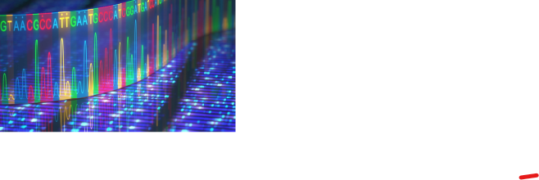
Genetics of alcohol metabolism in the Ugandan Population
Rodney Okwasiimire (BSc., MSc.)
Makerere University
UAPC 2022, Imperial Royal Hotel, Kampala

Slide 2
Alcohol burden
Consumption (Age,15+): 43% (world population) 32.3% (African population) are current alcohol consumers (WHO, 2018)
In Uganda: 36.3% (7.61 million) (WHO,2018), 30.5% (Swahn et al., 2018) and 26.8% (Kabwama et al., 2016)
Effects: 3M deaths per year, 5.1% of the disease burden (WHO, 2018)
In Uganda: 7.1% Alcohol Use Disorders, 2.5% Alcohol Dependence, Alcohol Attributable Fractions: 58.8% liver cirrhosis, 30.7% road traffic injuries, 5.8% cancer (WHO, 2018)

Slide 3
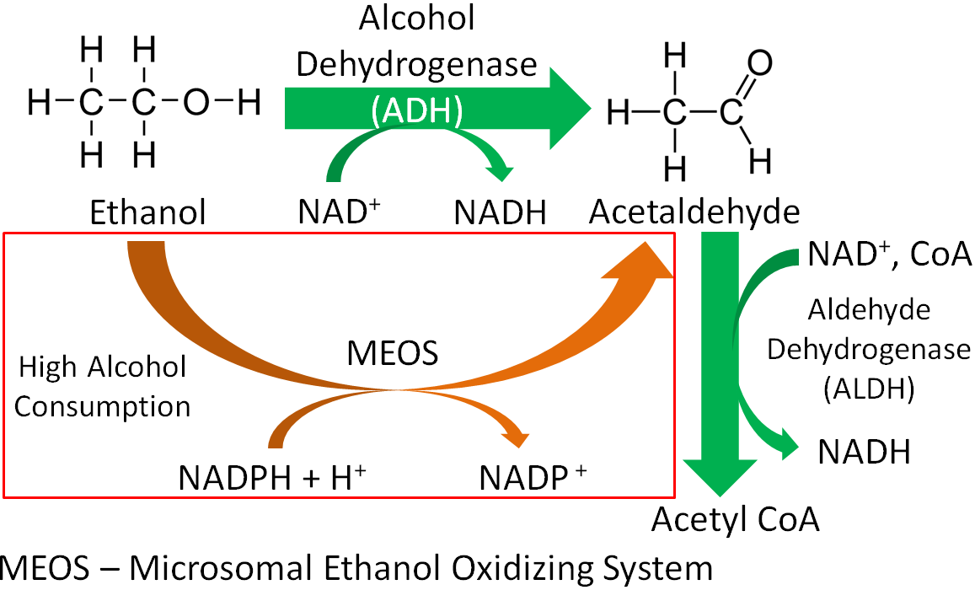
Alcohol metabolism
In the liver: >90%, breath: ≈0.7%, urine: ≈ 0.3%, sweat: ≈ 0.1% (Ramchandani et al., 2001)
Fig.1: Enzymatic alcohol breakdown

Slide 4
Alcohol & Aldehyde dehydrogenases
Class I ADH enzymes encoded by ADH1B & ADH1C genes account for most alcohol oxidizing activity
ALDH2 enzyme encoded by ALDH2 gene is the major aldehyde dehydrogenase
Table 1: Functional SNPs in ADH1B & ADH1C
Gene | SNP | Allele | Effect
ADH1B | rs1229984 – G (Arg) 47 A (His) | ADH1B*1 (Arg47Arg370) | 70 to 80 times higher turn over rate than the wild type
 | rs2066702 – C (Arg) 370 T (Cys) | ADH1B*2 (His47Arg370)
 |  | ADH1B*3 (Arg47Cys370)
ADH1C | rs1693482 – G (Arg) 272 A (Gln) | ADH1C*1 (Arg272Ile350) | 70% higher turn over rate than mutant
 | rs698 - A (Ile) 350 G (Val) | ADH1C*2 (Gln272Val350)
ALDH2 | rs671 - G (Glu) 487 A (Lys) | Loss of enzyme activity in the mutant | Loss of enzyme activity in the mutant

Slide 5
The alcohol genetics study in Uganda
250 Blood donors aged 16 – 56 yrs.
Extracted DNA
Genotyping by PCR-RFLP & Tetra ARMS PCR
5 polymorphisms genotyped
ADH1B rs1229984
ADH1B rs2066702
ADH1C rs1693482
ADH1C rs698
ALDH2 rs671
Fig.2: Study participants

Slide 6
Genotyping Results
Fig. 3 & 4: ADH1B Genotype frequencies

Slide 7
Genotyping Results
Fig. 5 & 6: ADH1C Genotype frequencies

Slide 8
Allele frequencies
Fig. 7 & 8: ADH1B & ADH1C Allele/Haplotype frequencies

Slide 9
Haplotype frequencies
Table 2: Effects of ADH1B & ADH1C Alleles
Allele | Effect
ADH1B*1 | Wild type
ADH1B*2 | 40-fold higher Vmax than wild type
ADH1B*3 | 30-fold higher Vmax than wild type
ADH1C*1 | Wild type
ADH1C*2 | Half Vmax of the wild type
ADH1C*new | Unknown
Agarwal, 2001; Edenberg, 2007; Edenberg et al., 2006; Zhakari, 2006
Fig. 9: ADH1B & ADH1C Haplotype frequencies

Slide 10
Discussion
ADH1B*1 - ADH1C*1 (48.4%) & ADH1B*3 - ADH1C*1 (1.2%) imply less acetaldehyde generation following alcohol intake
100% G/G genotype means no loss of enzyme activity
No protection against alcohol dependence & alcoholism
Protection against alcohol induced tissue damage, esophageal, head, neck & colon cancers
Outcome
Per capita alcohol consumption: Uganda 9.5, is higher than African (6.3) & the Global (6.4) (WHO, 2018)
Way forward/recommendations
Large scale studies with field samples for SNP distribution
Alcoholics
Regional/ethnic samples
Sequencing
Diagnostic/preventive markers

Slide 11
Acknowledgements
Dr. Denis Matovu Kasozi
Dr. Rhona K Baingana

